Slide 1
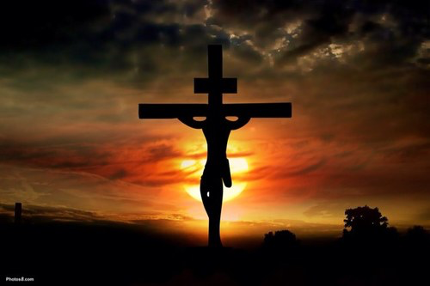
Race & Restoration Summit
Joining God in Healing the Church from the Sin of Racism

Slide 2
“How can we ensure that the purity of the Gospel is maintained and that we are not distracted by a focus on ethnicity as we pursue God’s Great Commission?”

Slide 3
1. Suspend Your Disbelief

Slide 4
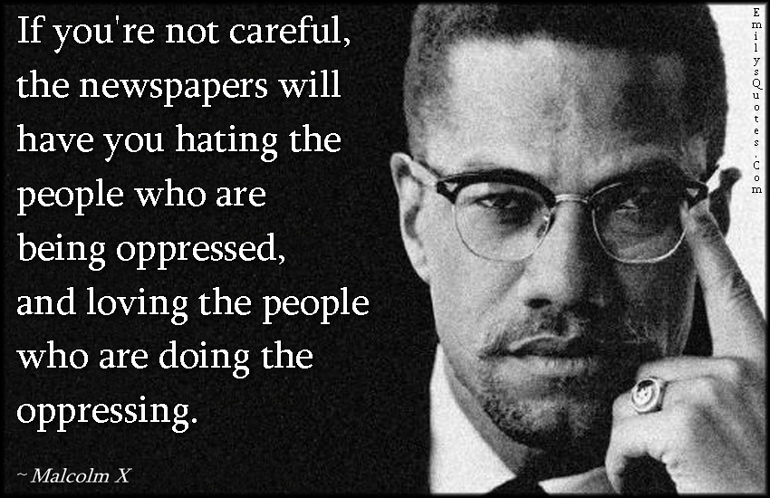

Slide 5
2. Cultivate Kingdom Eyesight

Slide 6
“But when He saw the multitudes, He was moved with compassion for them, because they were weary and scattered, like sheep having no shepherd. Then He said to His disciples, “The harvest truly is plentiful, but the laborers are few. Therefore pray the Lord of the harvest to send out laborers into His harvest.””
- Matthew 9:36-38 (NKJV)

Slide 7
3. Seek Purposeful Relationships

Slide 8
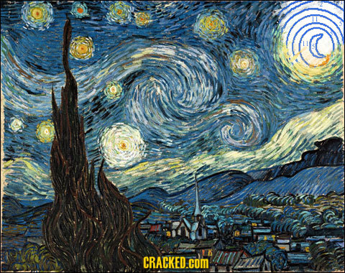

Slide 9
Mission?

Slide 10
Race & Restoration Summit
Joining God in Healing the Church from the Sin of Racism

